Slide 1
REalistiC Decisions
A practical grounding for the fair review of (health related) research
.

Slide 2
The Model
What is fair health care research review?
This slide set describes approaches to decisions we need to make when we design or review research.
It provides a model to shape our review, to help us analyse our judgements so we might make fair, shared and consistent decisions.
BUT while this slide set provides a model to shape our review, to help us analyse our decisions it doesn't claim to provide the standards or values we need, rather it explores their foundations.

Slide 3
The Model
What is fair health care research review?
Review is built on decisions that allow us to answer the questions
“Is this study ethically acceptable? Will we approve it?”
These decisions rest on our judgements, founded on our values and standards. The crucial questions are therefore
“On what did I base my judgement? What were my reasons?”
The aim of this model is to help answer these questions.

Slide 4
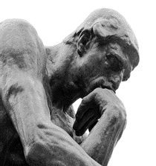
The Model
This model of research review
We hope this model will help:-
Structure our debate
Open up decisions for scrutiny
Explore and understand the reasons for our judgements
Assess the strength of these judgements
Widen the foundations we build these judgements on
Understand others’ judgements
Weigh and balance all views
Promote consistency
Develop consensus
Address disagreement and help resolve dispute
Counterbalance an individualistic approach
Address difficult and new issues

Slide 5
The Model
This model of research review
Two aims
Four steps
Eight “Es”

Slide 6
Two aims
To protect research participants AND facilitate ethical research
We must weigh up the harms and benefits for participants then balance these consequences for participants against the risks of unresearched health care to current and future patients. Our review is thus a complicated matrix, encompassing and accommodating risk and benefit to many people: participants, patients, the public, clinicians and researchers.
For more detail see
HARM
BENEFIT
http://www.testingtreatments.org

Slide 7
Four steps
I CONSTRUCTION
II DE-CONSTRUCTION
III JUDGEMENT
IV DISCUSSION AND CONSULTATION
.

Slide 8
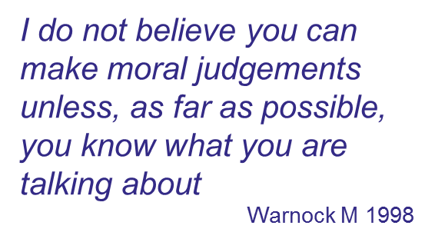
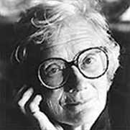
Four steps
STEP 1: Constructing a picture of the research
It’s important to recognise that factual errors are VERY likely to lead to ethical errors (and unnecessary argument).

Slide 9
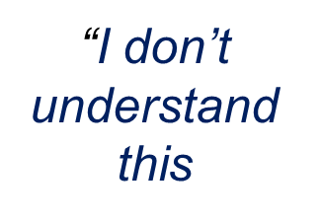
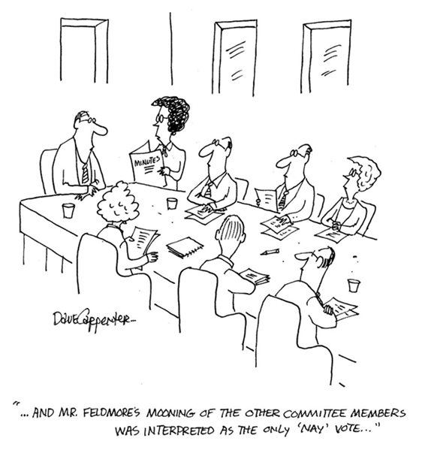
Four steps
STEP 1: Constructing a picture of the research
When we start, we need an overview of the study.
We need to
”find out what it‘s all about”
“determine the facts of the matter”

Slide 10
Four steps
STEP 1: Constructing” a picture of the research
This process of “construction” also has a further purpose.
It helps identify key ethical issues that will direct later analysis.
As an example, what are the likely ethical issues in
“A randomised controlled trial of pufficillin in children with Cystic Fibrosis assessing response by lung function”?

Slide 11
Four steps
STEP 2: breaking the study into ethical domains
Step I, “Construction” doesn’t permit judgement. While it might provide “pointers” it lacks sufficient detail to allow a full analysis. For this we need to break the study down into what we might call its constituent “ethical domains”.

Slide 12
Four steps
STEP 2: Ethical domains
1 Based on IRAS*
Independent review
Social and scientific value
Suitability of applicant and support
Recruitment, access to information
Inclusion and exclusion .
Risk, harms and benefits
Consent and participant Information
Confidentiality
Payment to participants
Compensation, insurance
End of trial arrangements
2. After Emanuel et al
Social or scientific value
Scientific validity
Fair subject selection
Favourable risk benefit ratio
Independent review
Informed consent
Respect for potential and enrolled subjects
JAMA. 2000;283:2701-2711
What Makes Clinical Research Ethical?
*Integrated Research Application System http://www.myresearchproject.org.uk

Slide 13
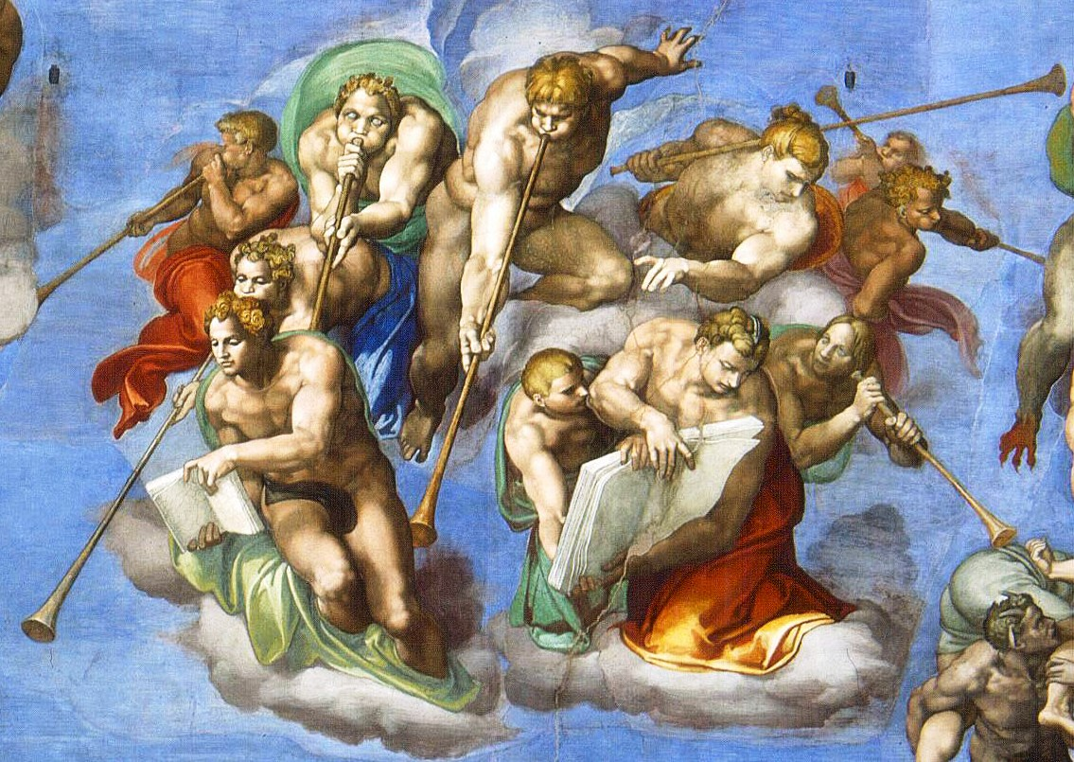
Four steps
STEP 2: Ethical domains
Within each we can then ask specific questions, judge and reach our decisions.

Slide 14
Four steps
STEP 3: Judgement and decision
To analyse and debate our decisions, it’s helpful to look at their underpinning foundations – why we hold a particular position.
I propose these rest on 8 “Es” or 8 questions, outlined in the next slide.
Application
Decision
Judgment

Slide 15
Eight “Es”
“Es” Questions
Ego How would I decide (if it were me)?
Emotions How do I feel about this proposal?
Empathy How might the potential participant decide?
Expertise What expertise is there in committee, what peer review and external expert guidance is available?
Experience What have I / we decided before?
Ethical theory What would an ethical analysis suggest is fair?
Evidence What published evidence is available?
Expediency What is possible and realistic?

Slide 16
The
Application
The 4 steps and eight “Es”
Construction and
de-construction
Emotions
Empathy
Expertise
Expediency
Ego
Experience
Evidence
Ethical theory
Debate
Decision

Slide 17
Eight “Es”
How would I decide (if it were me)?
Ego
This is often our first strategy. Its foundations can be complex. While it might be seen as an immediate judgement through
Intuition
Emotion: (Blackburn's staircase of emotional ascent in “Ruling Passions”)
System 1, Fast thinking: (Kahneman’s “Thinking, fast and slow)
Thin slicing: (Gladwell’s “Blink”)
Pattern recognition
it may be founded on more considered foundations, on other “Es”.
This immediate judgement has its place but anyone using this must be prepared to be challenged.
It’s not an ideal way to finish debate: openness and achieving consensus will be problematic.

Slide 18
Eight “Es”
Emotions
How do I feel about this proposal?
Our judgements may be (and often are) founded on our emotions (Blackburn’s desires, attitudes, passions, impulses whims, stances dispositions and sentiments).
Some find these “uninviting allies” for rational thought, others argue that such emotions are a fair and valid foundation for our judgements. (“If I’m revolted, others may be as well.”)
As with “Ego” this approach may be a start but is unlikely to provide satisfactory consensus.

Slide 19
Eight “Es”
How would the participant decide?
Empathy
Often quoted by REC members as their approach, it would theoretically seem to provide fair foundations for judgement. Its validity, however, is contended.
We need to accommodate the criticism that our capacity for empathy is limited and needs validation by other approaches.
Here there’s a crucial role for public involvement.
Researchers should consult patients and potential participants asking “Is the research question relevant to your needs? Is the burden of participation acceptable?
Is this a fair proposal to put forward? Would YOU join it?”

Slide 20
Eight “Es”
Applying expertise and guidance
Expertise
When tackling any problem we should use all available expertise and guidance, and there is much available in this field. But this has to be examined to determine its authority and independence and how it can be applied to the study being considered.
While we should follow expertise and guidance, it shouldn’t be seen as a rigid straight jacket. However if decisions run contrary to guidance, clear reasons must be presented.

Slide 21
Eight “Es”
Experience
What have I / we decided before?
Descriptions of past case or cases, recollections of moral positions previously adopted, recall of evidence and previous decisions can speed review and provide consistency.
This may not be explicit conduct in Research Ethics Committees but probably does shape individual opinions and decisions. More formal ways to record these are needed.
Differences between projects must be accommodated.

Slide 22
Eight “Es”
Ethical
theory
Ethical theory in research review
Ethical theories help us explore or “interrogate” a study but don’t provide us with judgement.
Ethical theories play a key role in
Setting out questions we should ask
Defining “moral maxims”
Designing or reviewing new research using novel methods
Designing or reviewing contentious research
Taking the sting out of committees in dispute
Helping us explore the reasons for our opinions
“we can no more learn to act rightly by appealing to ethical theory.. Than we can play golf by appealing to mathematical theory of the flight of the golf ball”
Dworkin

Slide 23
Eight “Es”
Evidence
What published evidence is there?
Evidence can provide us with the views of the public and patients and the acceptability of research. Systematic reviews of this evidence can limit bias and help us include all views when making a decision. As examples it can inform us about the likely harms and benefits of research and improve information for potential participants.
But facts don’t lead directly to judgement. Evidence contributes to, and supports our decisions but it doesn’t make them!
Our evidence base is also limited. There is a need to research research (and research ethics).

Slide 24
Eight “Es”
What is possible and realistic?
Expediency
Ethical research is a public good. Evidence based care has revolutionised and improved our lives.
So review needs to be pragmatic and importantly proportionate but this call for “expediency” can’t be a licence for unethical research. We need to be expedient but challenge this if it conflicts with other considerations.
This is reflected in guidance.

Slide 25
Eight “Es”
.
Fitting the “Es” together
The “Es”
EGO and EMOTION are individual views. To seek consensus, they need to be explored.
EMPATHY should be validated by consultation.
EXPERTISE precedent needs to be considered and justified.
EXPERIENCE needs occasional challenge.
ETHICAL THEORY can not be a final arbiter.
EVIDENCE only provides a “scale” and indicate social views.
EXPEDIENCY Pragmatism doesn’t justify the unethical.
Notes:
To

Slide 26
Four steps
STEP 4: Working together
To reach a shared decision we must
Resolve uncertainties so we all have an accurate picture of the research.
Put forward our views concerns and suggestions.
Listen to those of others.
Reach agreed judgments, decisions and remedies.
Vest authority in those who will follow up issues.
Skills needed are on the next slide.

Slide 27
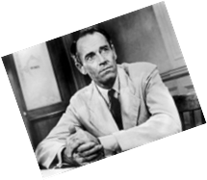
Four steps
STEP 4: Working together: necessary skills
To read the studies | Commitment
To try to understand the context of the research | Critical appraisal and imagination,
To consider all involved | Empathy and respect
To identify and work out any ethical problems in the research | Clarity of thought
To express opinions and judgments | Clarity of thought and expression
To identify, understand, and accommodate others’ opinions | Listening, respect and humility
To accept and weigh up arguments to make a decision | Respect and humility
To accommodate disagreement but if necessary stand firm | Humility and confidence
To identify and question our own convictions and values | Insight

Slide 28
Conclusions
What does fair health care research review look like?
Open to scrutiny.
Based on an accurate picture of research
Accommodates the research context
Founded on ethical reasoning, expertise, experience and evidence we can debate
Takes into consideration, and balances, the interests of all parties.

Slide 29
The end.
We hope this helps you!
Please provide any feedback to hughdavies@nhs.net

